Slide 1

SAMSUNG PRISM
Generative AI
Hackathon
3rd Edition 2026 – 27
Theme ID - 2
Team Name –Brutal Bruteforcers
College Name -MSRIT
Member Name & Email 1- Aadi Yathaarth Kulshrestha & 1ms24cs001@msrit.edu
Member Name & Email 2- Aditya Hegde & 1ms24cs010@msrit.edu
Member Name & Email 3- Chinmay Panghri & 1ms24cs054@msrit.edu
Submission Github link - https://github.com/Aadi546/prism_project.git

Slide 2
Theme
Theme 2: Smart Guided Troubleshooting Engine
What customers actually type (kit input.txt)
What the engine sends back
Follow these steps to perform this Touchscreen Troubleshooting
“My Nexa X1 screen inputs are delayed and the touch responsiveness is laggy.”
auto
Enable Touch Sensitivity
voiceassist://masked/act/14eb42b895
“My smartphone's screen is completely cracked.”
manual
Check the Charger
no link, done by hand
“My Nexa X1 Ultra screen is completely black and won't turn on.”
critical
Restart in Safe Mode
unlocked only if the rest fails
Goal: a vague complaint in, an ordered plan out, where every Settings step opens in one tap. Today that takes an agent ~15 minutes per ticket. The brief asks for < 300 ms on known issues and < 8 s on new ones.
Notes:
Theme 2 is about turning vague complaints into a plan the phone can act on. On the left are three complaints straight from the kit. None of them name the setting that's wrong. On the right is a cut-down version of what our engine returns for the first one: an ordered plan with a one-tap link for the Settings step, a physical check, and a last-resort step that only unlocks if the others don't help. Right now an agent does this by hand in about fifteen minutes.

Slide 3
Existing Solutions & Gaps
How it's done today
What we found missing
1
Agent reads the SIIS article
long help pages, half of it background
Where | Gap
Brief | validationDeeplink exists in the schema, but nothing says how to fill it, so no one checks the fix worked
Brief | “Return empty if no viable fix” is never defined, and a search always returns something
Brief | One problem per message is assumed. One kit complaint has three
Brief | A wrong plan in the cache is served to every paraphrase of it
Starter code | Titles cut to 3 words (“Some things to”), factory reset marked as a one-tap step
Starter code | Rule compliance 5%, 0% cache hits on real rephrasings
2
Picks and orders steps by hand
different agents, different answers
3
Customer digs through menus
Settings > Display > Navigation bar
~15 min
per ticket, per the brief
Notes:
Today an agent reads the article, picks steps by hand and the customer hunts through menus. When we read the brief closely we found holes: the validation field has no rule, 'return empty' is never defined, and multi-problem messages aren't covered. We also ran the starter code on the kit: titles were cut off, a factory reset was a one-tap step, and only five percent of plans passed the brief's own rules.

Slide 4
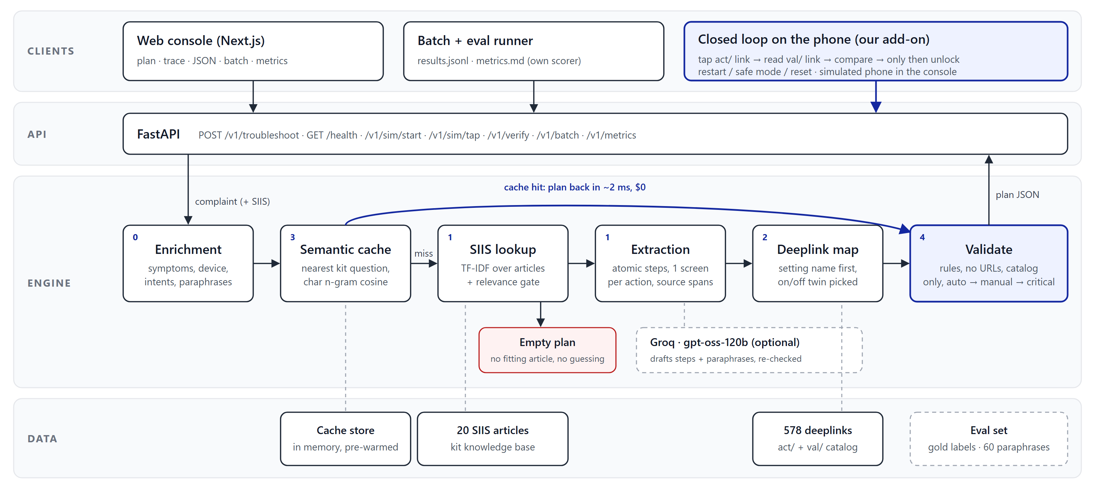
Our Solutions & Architecture Diagram
Offline by default: a new complaint takes ~30 ms, a cached one ~2 ms. The LLM is optional and never gets the last word: its output goes through the same checks.
Notes:
Four layers. On top, the clients: our web console, the batch and eval runner, and the closed-loop phone check. They all call one FastAPI service. In the engine, a complaint is enriched first, then we try the semantic cache. On a hit the plan comes back in a couple of milliseconds. On a miss we look up the SIIS article, stop with an empty plan if nothing fits, extract steps, map each Settings step to its exact catalog deeplink, and validate everything against the brief's rules. Groq is optional and only drafts; our validators decide.

Slide 5
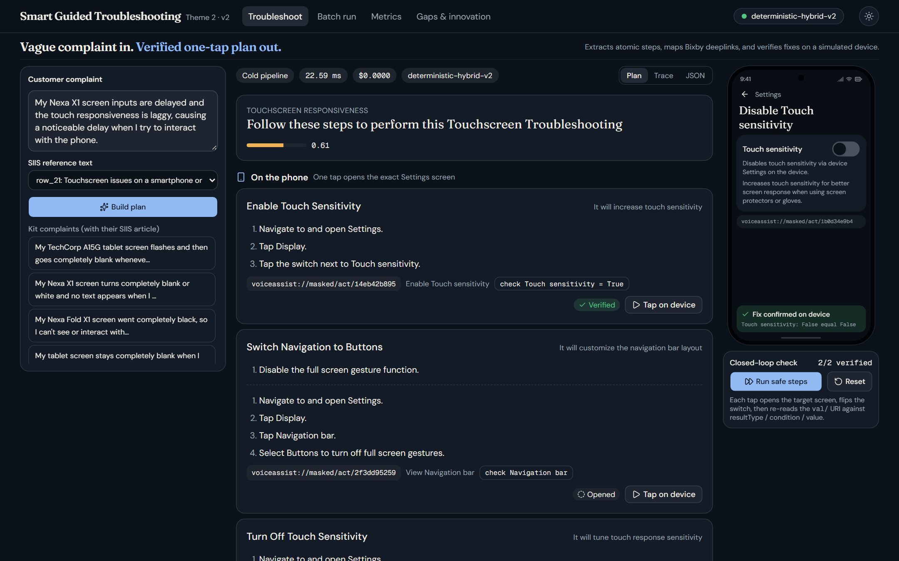
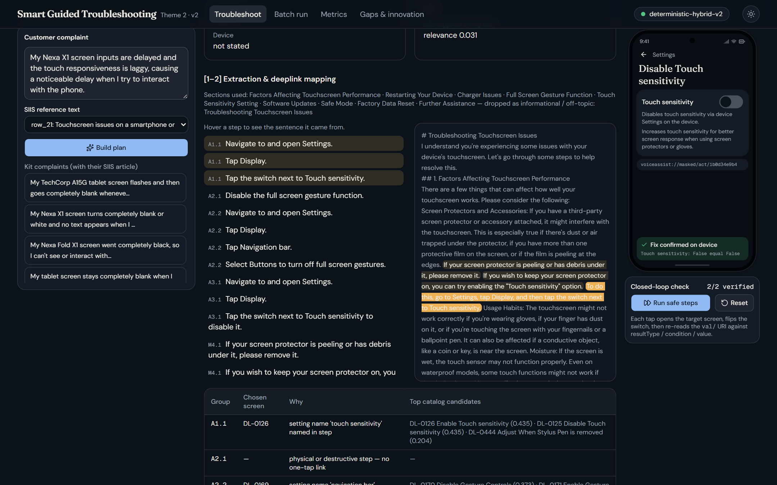
Demo & Product Walkthrough
Trace tab: hover a step, its source sentence lights up
1
Pick a kit complaint (or type one)
2
Plan comes back in 3 tiers: phone, by hand, last resort
3
Run safe steps: the phone opens each screen and reads the setting back
Touchscreen complaint with its SIIS article, then Run safe steps. Pages: Troubleshoot, Batch run, Metrics, Gaps.
4
Trace + JSON tabs: where every step came from
Notes:
Recording order: pick the touchscreen complaint, show the plan in its three tiers, press Run safe steps and watch the phone open each screen and confirm the setting, unlock the last-resort tier, then open the Trace tab and hover a step to show the exact sentence it came from. Finish on Batch run for all twenty complaints.

Slide 6
Tools and tech stack used
Engine
Retrieval
LLM (optional)
Console
Testing
Python 3.12
FastAPI + Uvicorn
Pydantic (kit schema.py)
scikit-learn TF-IDF
word + char n-grams
NumPy / SciPy
Groq Cloud
openai/gpt-oss-120b
OpenAI-compatible client
Next.js 16 + React 19
Tailwind 4 + shadcn
light / dark theme
pytest
own Appendix C scorer
gold labels, 60 paraphrases
used for
REST API, validators, simulator
used for
SIIS lookup, deeplink map, cache
used for
drafts get re-checked, falls back offline
used for
plan, trace, phone simulator
used for
before/after numbers
Runs with no API key at all. The default path is deterministic and costs $0 per query; a GROQ_API_KEY in .env switches the LLM path on.
Notes:
The engine is plain Python with FastAPI. Retrieval is scikit-learn TF-IDF, no GPU and no paid model needed. The LLM path uses Groq's gpt-oss-120b and is optional. The console is Next.js with a light and dark theme, and we test with pytest plus our own scorer for the Appendix C metrics.

Slide 7
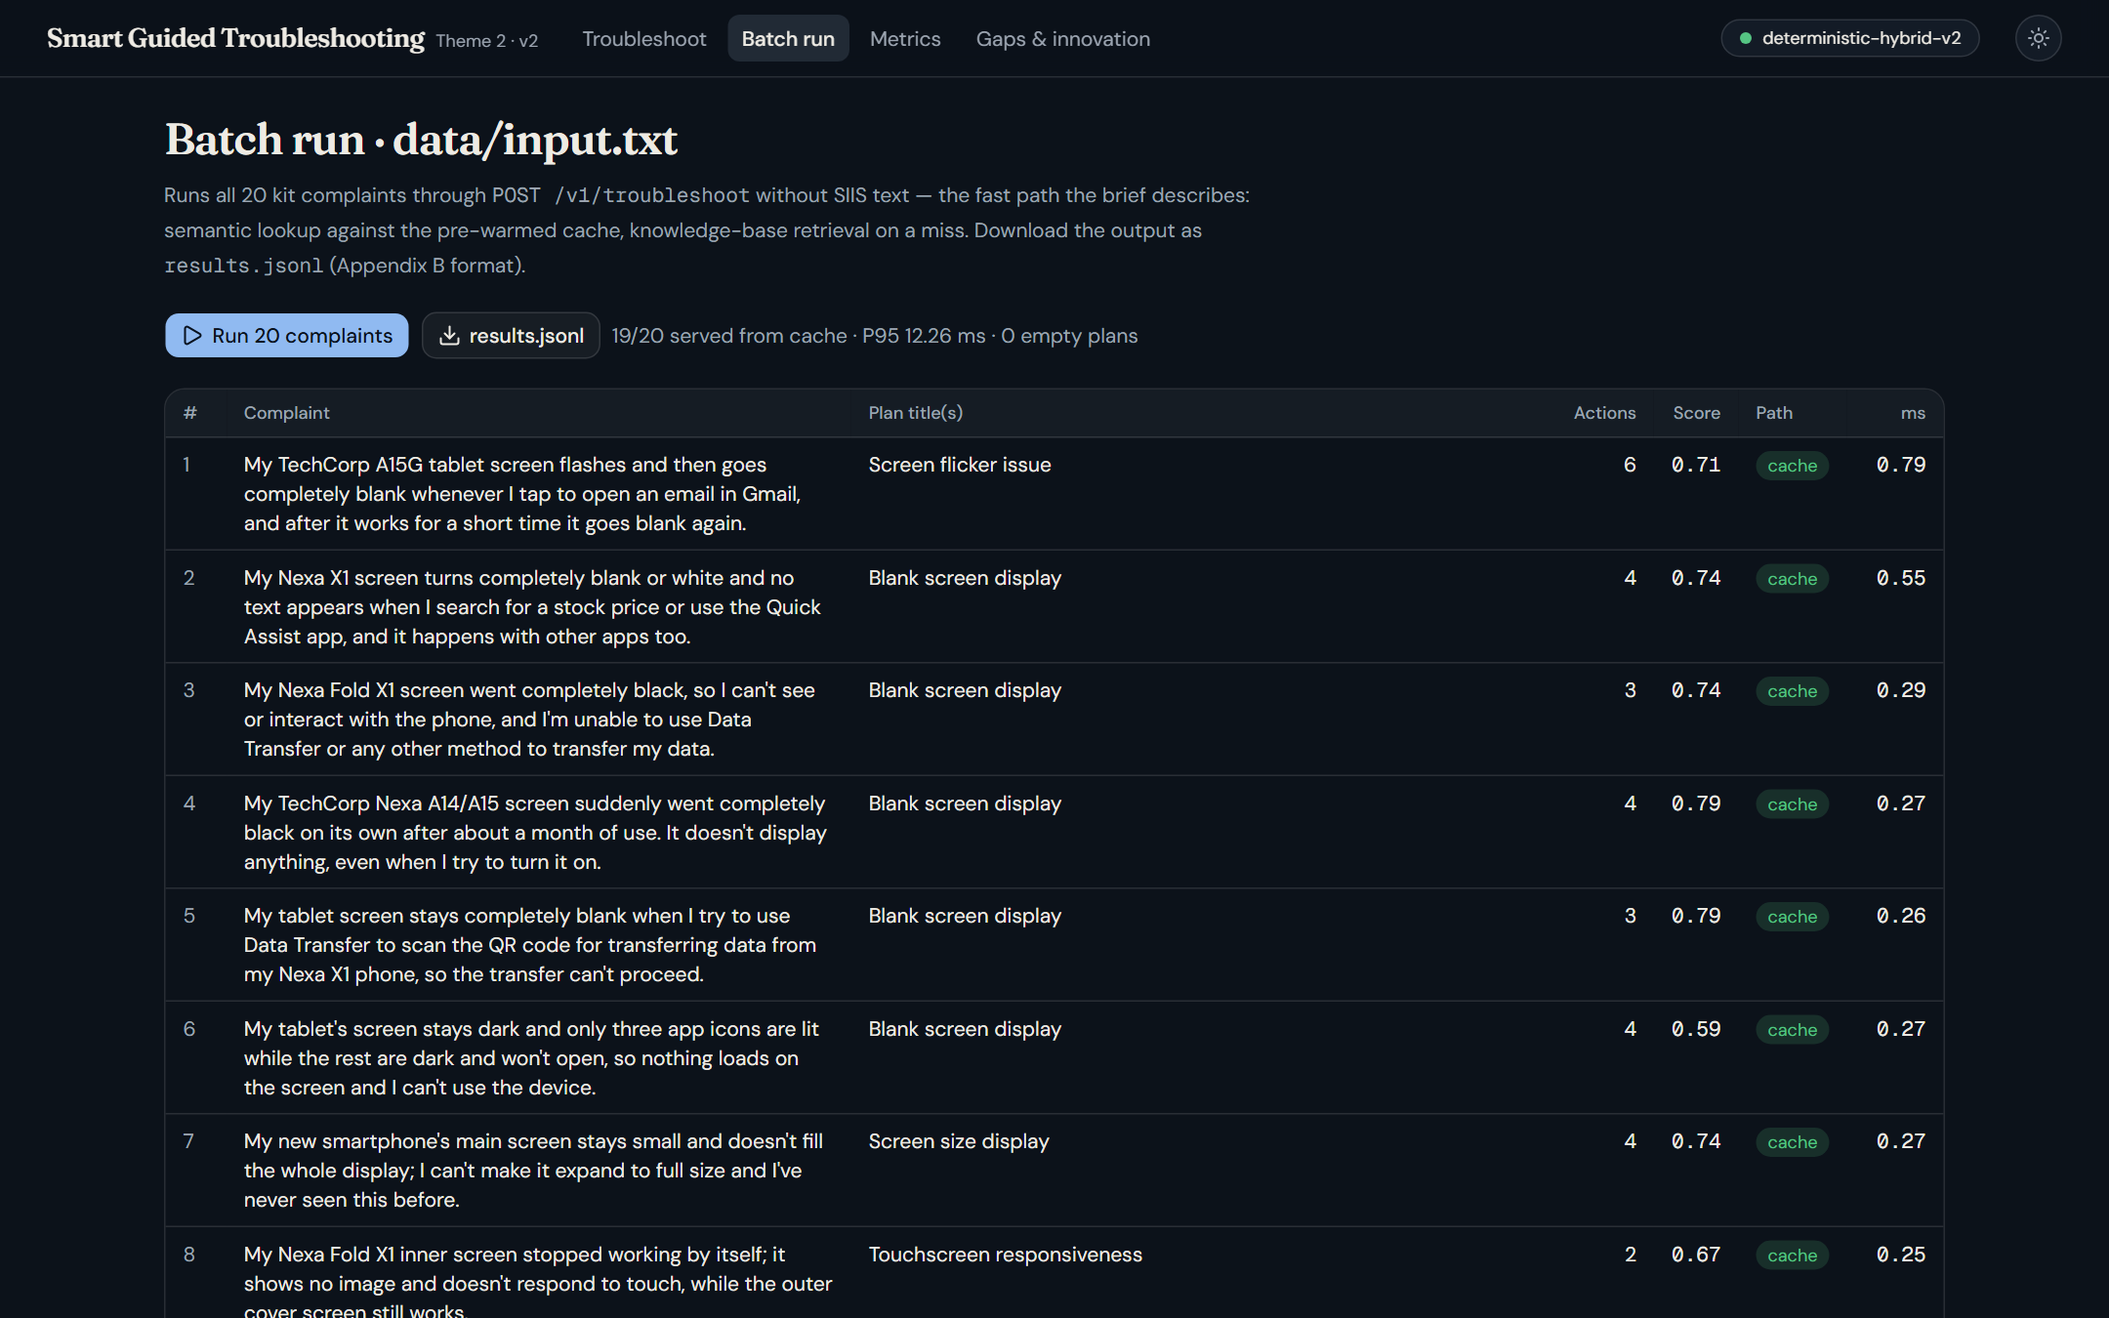
Impact & Use case
110 ms
P95 for a brand-new complaint
vs ~15 min manual, target 8 s
2 ms
P95 when the cache already knows it
$0, no model call
87%
of 60 unseen rephrasings answered from cache
was 0% before
A typical ticket
1
“Nexa X1 touch is laggy and inputs are delayed”
2
Plan: Touch sensitivity, nav bar to buttons, check the charger
3
Phone confirms each setting really changed
4
Still laggy? Only then restart, safe mode, reset (backup first)
Batch run: all 20 kit complaints in one go
Notes:
The three numbers are from our metrics run. A new complaint is answered in about a tenth of a second at worst, a known one in a couple of milliseconds with no model call, and most rephrasings are recognised from the cache. For a customer it means one tap per fix, and the disruptive steps only come up when they're really needed.

Slide 8
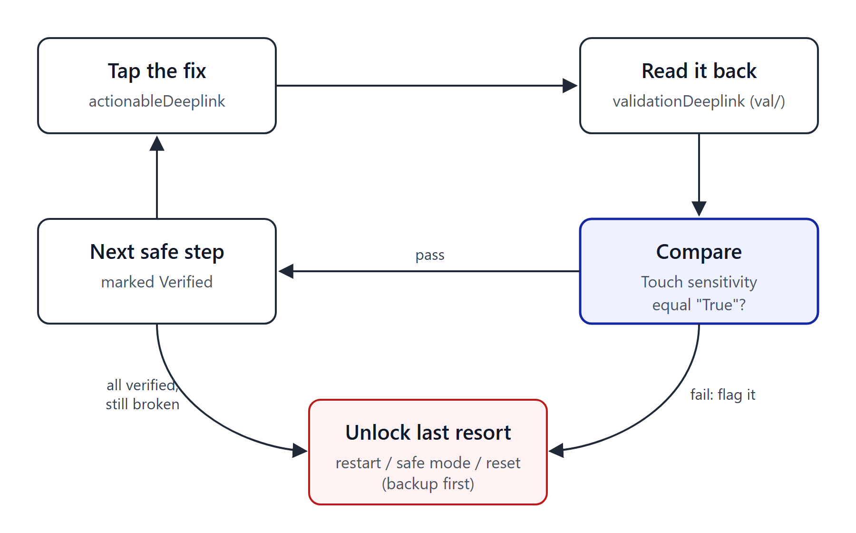
Innovation highlights, results and limitations
Before (starter code) vs after, same scorer
Innovation: check the fix actually worked
Step accuracy 2.74 → 2.94 (of 3). URL leaks 0, catalog-valid links 100%. LLM mode (openai/gpt-oss-120b) works, ~$0.0011 per LLM-made plan; on Groq's free tier only 5% of batch plans got through before rate limits, the rest fell back offline.
We fill validationDeeplink from the catalog: onURL means expect True, offURL means False, updateURL means the value went up or down.
On the kit, 2 of 3 simulated toggles were confirmed. Restart and reset stay locked until the safe fixes are done.
Also: step-to-sentence trace, relevance gate, one plan per problem.
Limitations
A few kit complaints come with only loosely related articles; the score drops, the plan stays honest.
12% of rephrasings hit a plan from a neighbouring article. The phone is simulated.
Notes:
Left: the same scorer run on the starter code and on ours. Rule compliance goes from five to a hundred percent, and every Settings step now lands on its exact screen. Right is the part we're proudest of: a one-tap link only proves a screen opened, so we read the setting back through its validation link and only then move on. We're upfront about the limits: the phone is simulated, and a few kit complaints only have loosely related articles.

Slide 9
What’s next
1
2
3
4
Real device check
Run the val/ reads through the voice agent on a real phone instead of our simulator.
Learn from outcomes
Log which fix actually closed the ticket and rank plans with that.
Hindi / Hinglish
Most complaints in India mix languages. Add normalisation and multilingual embeddings.
Per-device screens
Fold cover vs inner display, tablets. We detect the model already; the catalog doesn't split yet.
Soon: warm the cache from real ticket history, and move to a paid LLM tier so it isn't rate-limited.
Notes:
Next steps, roughly in order. The most important is running the closed loop on a real phone, since today it's simulated. Then learning from which fix actually solved the ticket, supporting Hindi and Hinglish complaints, and per-device screens.

Slide 10
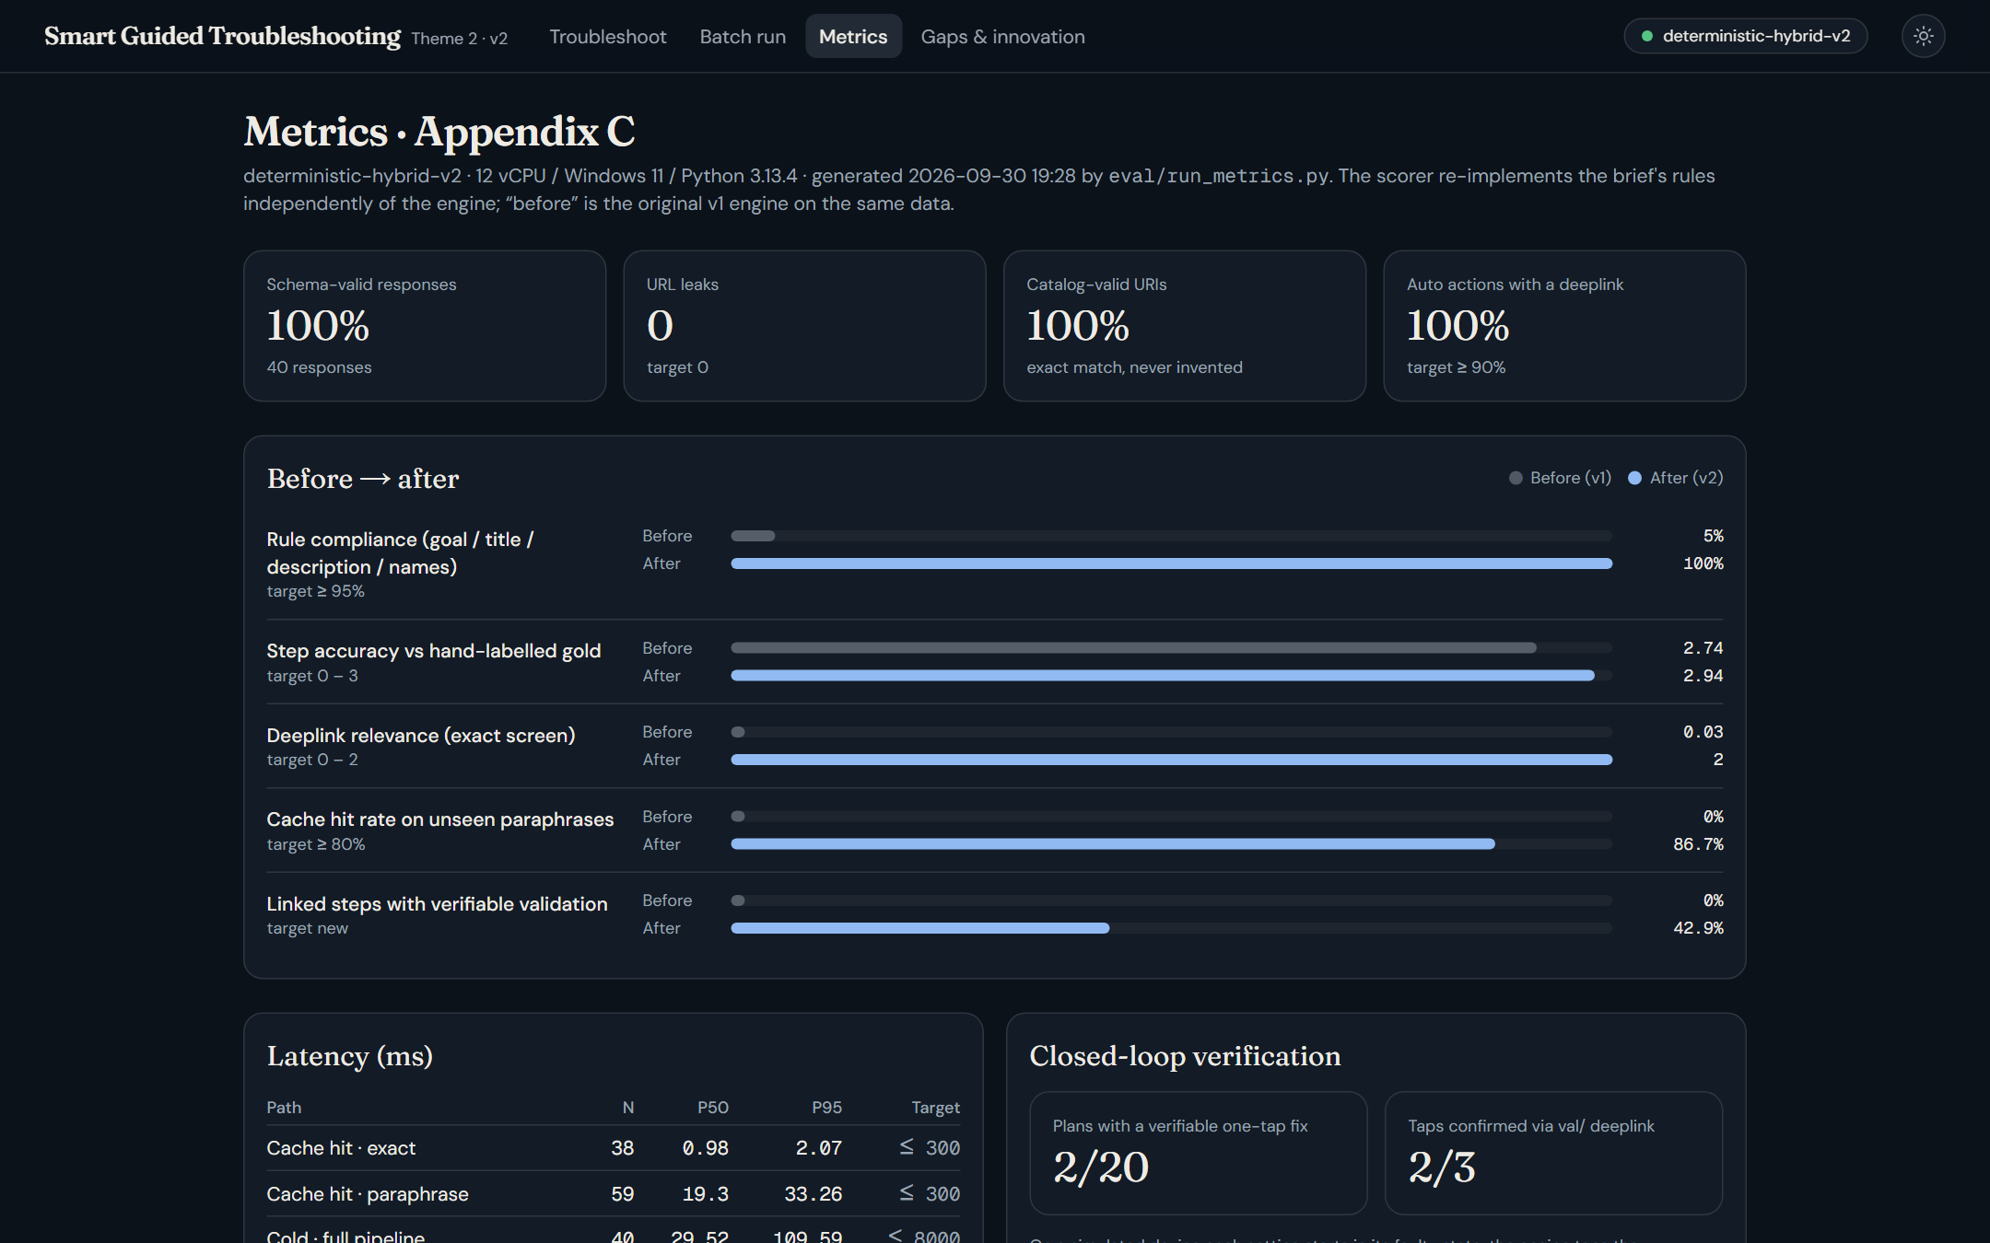
Brownie points ( differentiation)
We measured it
Our own scorer, hand-labelled gold and 60 rephrasings we wrote. Run on the starter code too, so the “before” is real (5% → 100% rule compliance).
Fixes get checked
A deeplink only proves a screen opened. We read the setting back and only then move on.
Nothing made up
Every step points to the sentence in the SIIS text it came from. No fit means an empty plan, not a guess.
Works offline
No API key needed, $0 per query. The LLM is an optional extra, re-checked like everything else.
Metrics page in the console, same numbers as metrics.md
Notes:
What sets us apart: we measured ourselves honestly, including the starter code; our fixes get checked, not just linked; nothing in a plan is invented; and it all runs offline for free.

Slide 11
Checklist- Updated on Public GitHub
Working prototype code — public or shared GitHub repo (Y/N) Y
README with reproducible setup instructions (Y/N) Y
Demo video, max 5 minutes (YouTube or Drive link) link: https://youtu.be/HOXW_BEBL_s?si=me-_9JaS3cTX85TM
Presentation file (PPT or PDF) (Y/N) Y

Slide 12
Thank you
Organised by the Language AI Team and the PRISM Team, Samsung R&D Institute India
Notes:
Closing slide. Add the Google Form URL and a contact email before sharing. Edition 2 organising team for reference: Language AI - Sourabh Tiwari, Gaurav, Sanjeeth Pothireddy, Gorang Maniar; PRISM - Binny Lakra, Prakhar Chandrakar, Vishu Kumar; Kick-off and mentors - Giridhar Jakki, Deepraj Prabhakar Patkar (Language AI), Srimanu Prasad Nagaraju, Ashish Kumar (Tech Strategy).

